Slide 1

California Wildfires Visualizing a decade of destruction
Project 3, Group 2
Iryna
Julio
Elijah
Joe

Slide 2
Images of the Dixie Fire in Northern California have dominated news stories for the last month. How can we visualize what is happening with wildfire in California interactively in an accessible format?
It feels like everything out West is on fire. Especially in California.
One fire doesn’t tell a story.
Seven years of fire records mapped across the State of California with interactive drop-down menus showing all fires in terms of acreage and duration does.
User interface facilitates exploration of a dataset containing all fires from 2013 through 2019 by duration and size and mapped location.
Notes:
Dixie fire started July 13. Has currently burned 570,000 acres and is still not contained. 640 acres in a square mile. 890 square miles. 30mile x 30mile. Beltway 8 is roughly 23x23

Slide 3
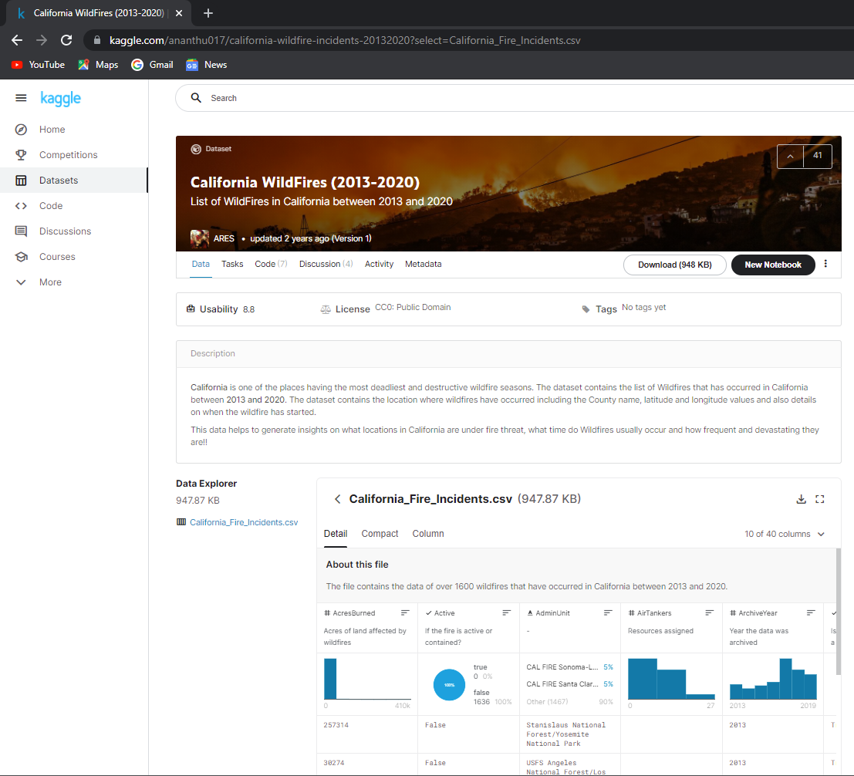
Data Sources
Kaggle:
https://www.kaggle.com/ananthu017/california-wildfire-incidents-20132020?select=California_Fire_Incidents.csv

Slide 4
Data and Data Delivery
CSV in Kaggle
PG Admin & Routes
Flask
Identify adequately large data set on Kaggle (1636 entries)
Drop erroneous data
Drop unnecessary columns containing NAN values
Dropped duplicates (Single fires spanning multiple counties, etc.)
Clean (1023 entries)
Read and process data using Python
Feed clean data to PG Admin using SQL Alchemy
Read data from SQL Alchemy using custom queries
4 routes
Each route uses custom SQL query via SQL Alchemy interface
Route returns JSONified object

Slide 5
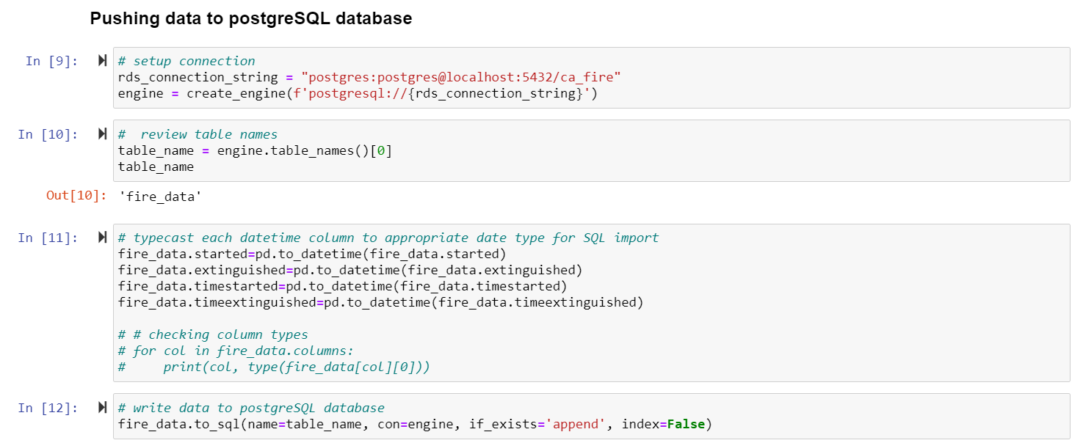
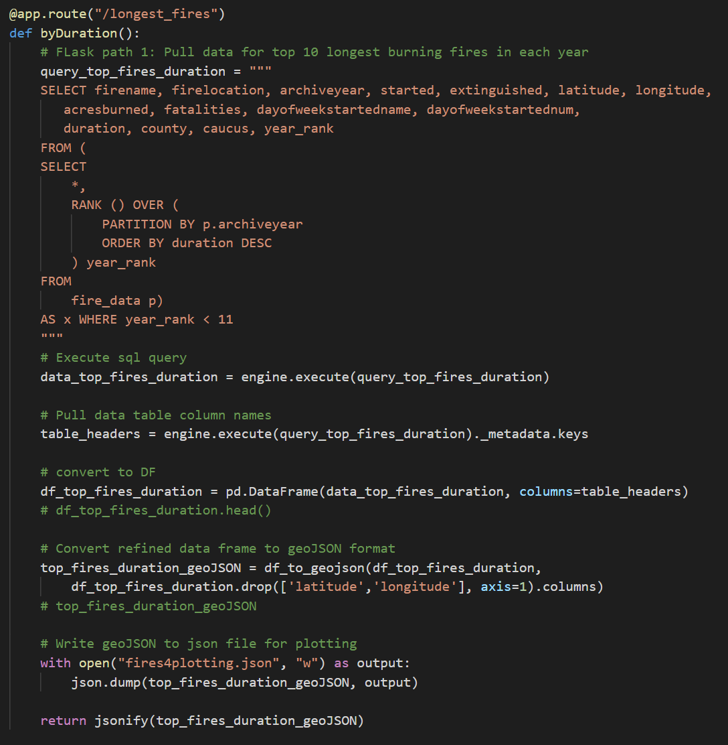
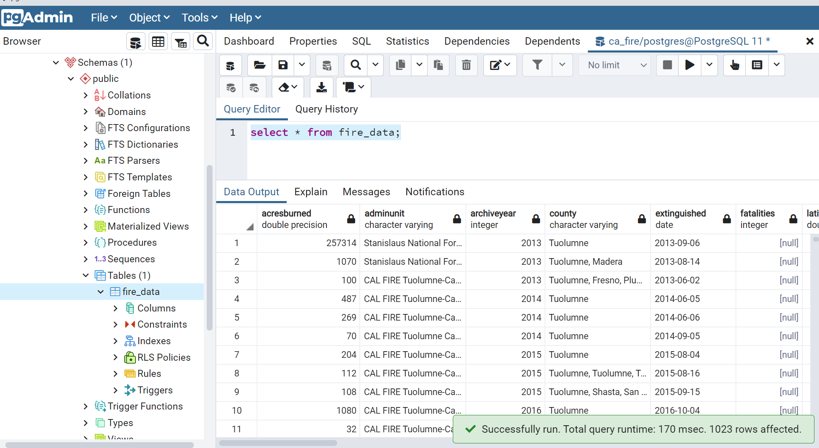
PG ADMIN and Routes

Slide 6
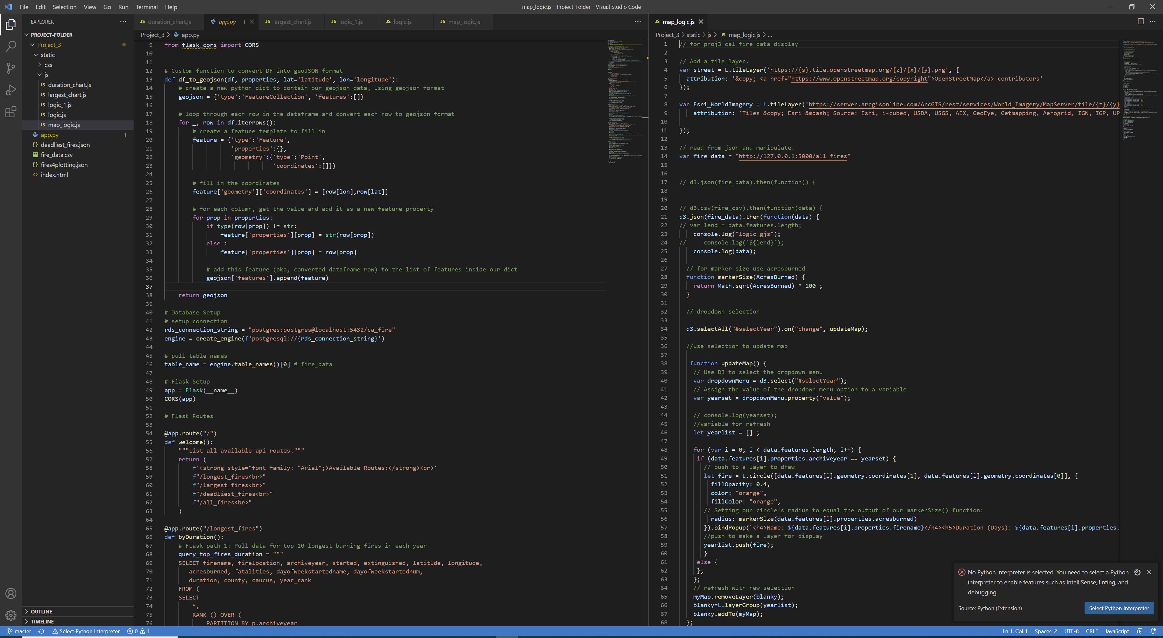
Tools and Technologies Utilized
Data processing in Jupyter Notebooks
JSONs & GEOJSONs
Python Flask
Leaflet
Chart.JS
Bootstrap

Slide 7
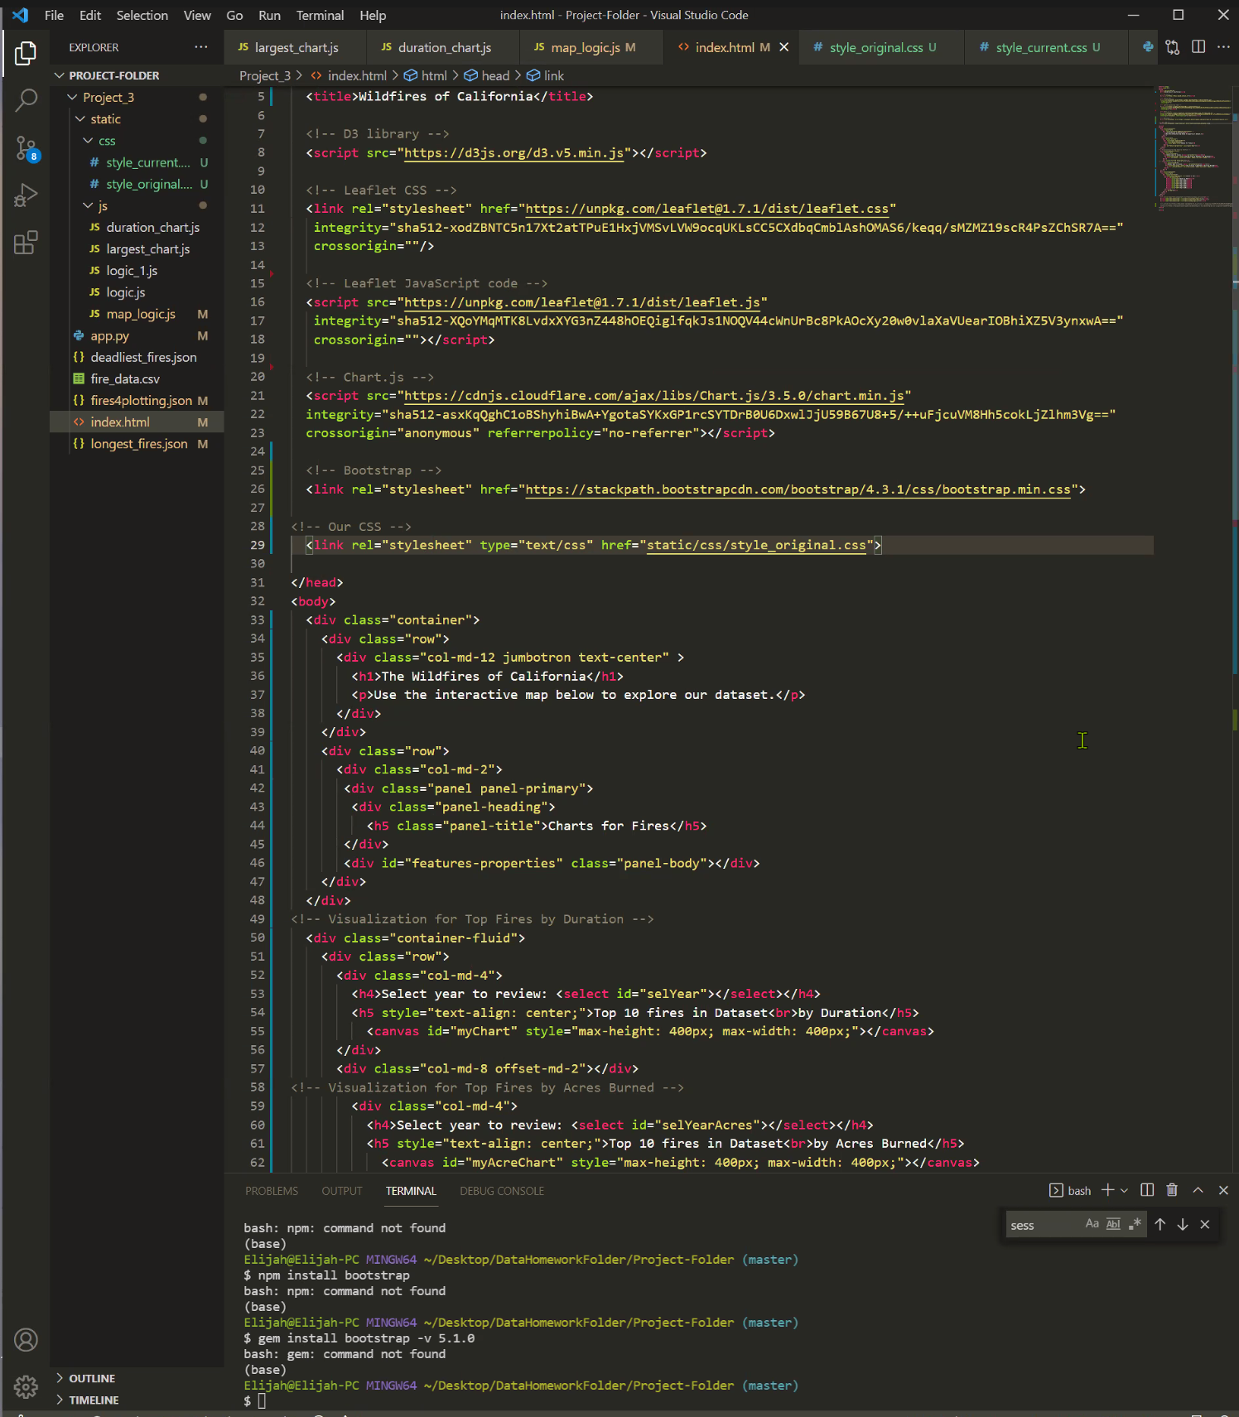

HTML in Visual Basic Studio and the Bootstrap Grid

Slide 8
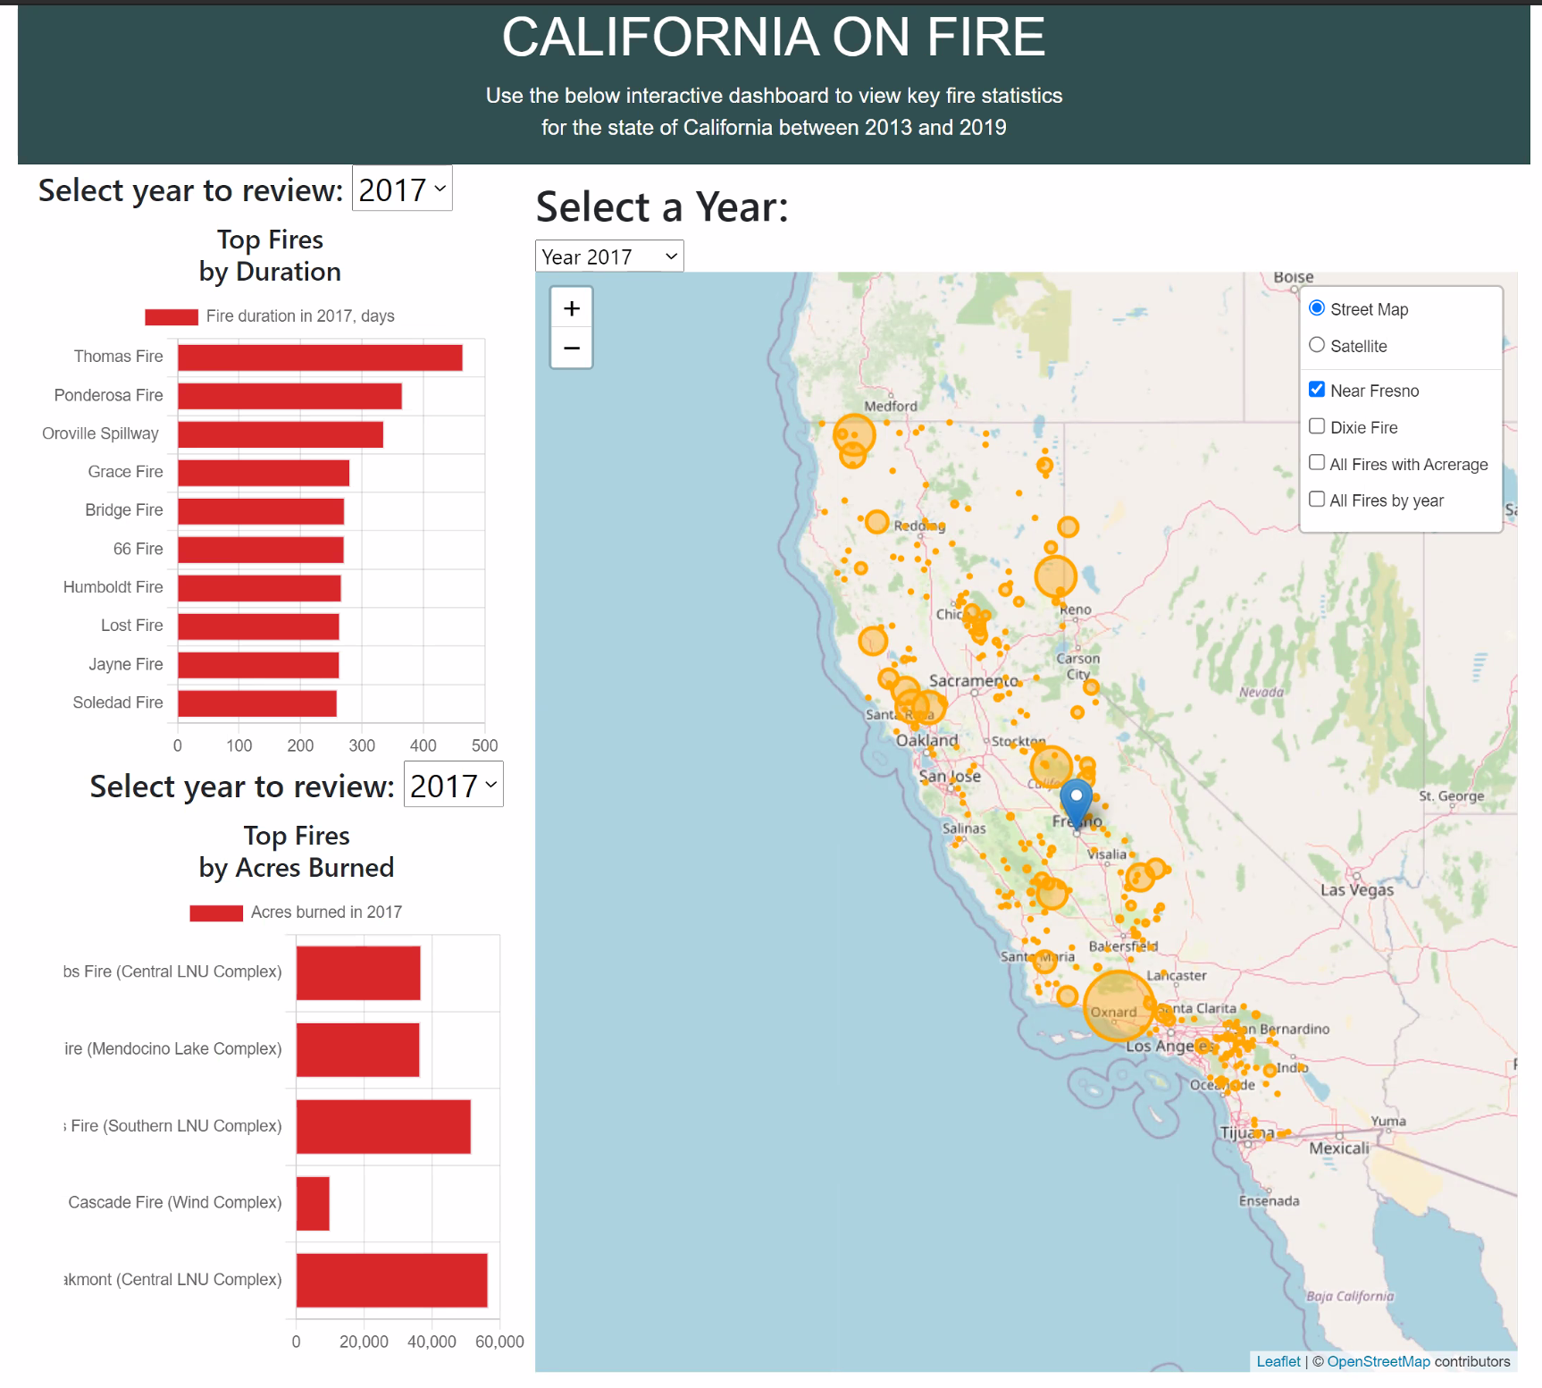
The Interactive Dashboard

Slide 9
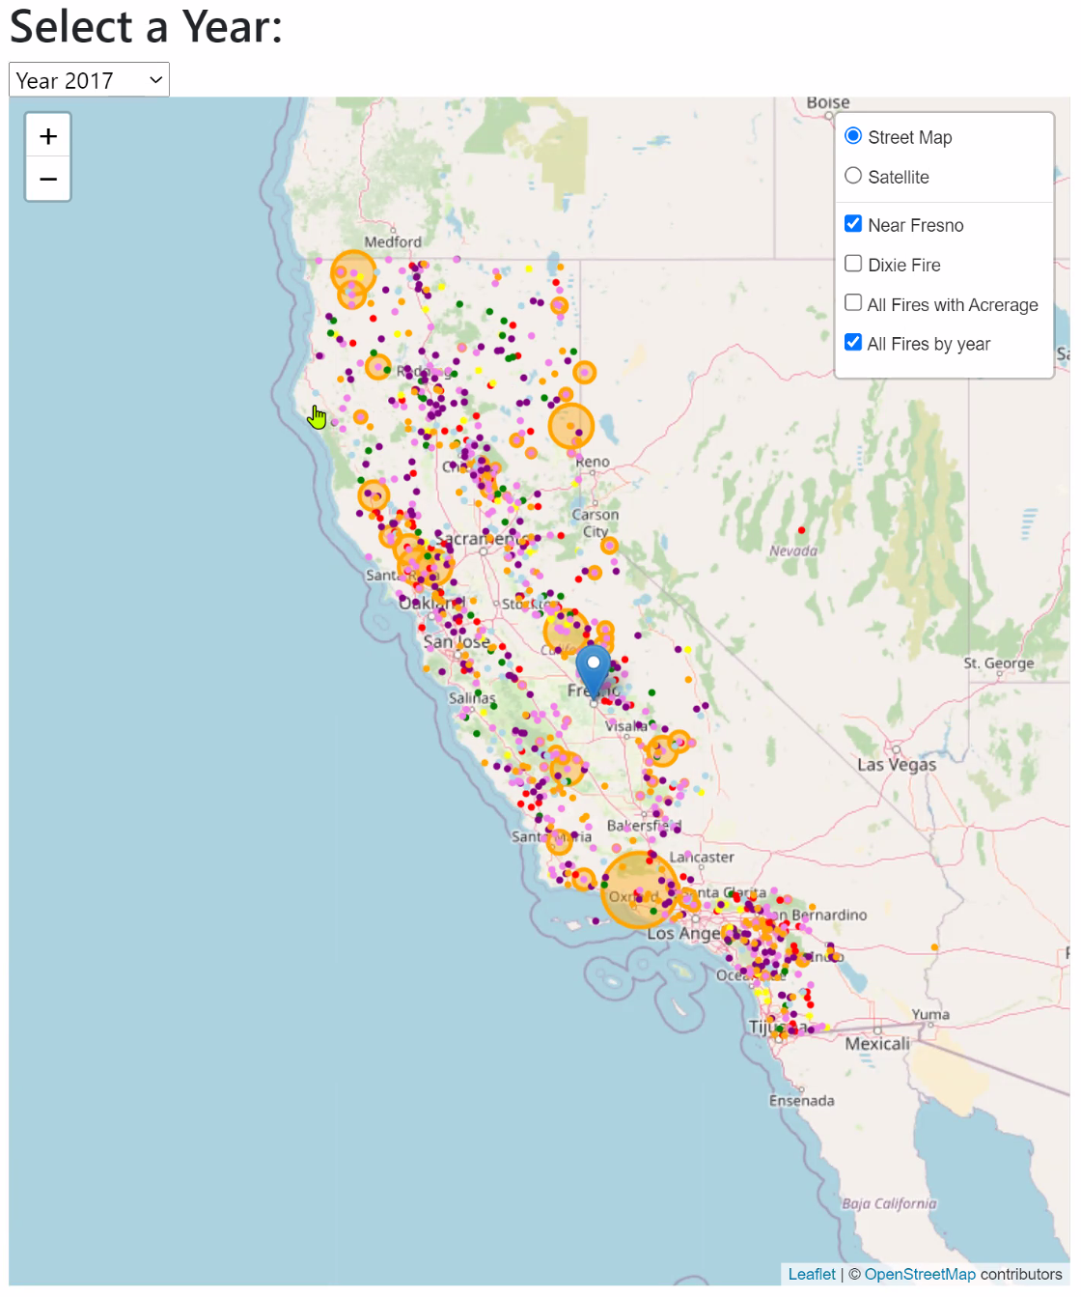
The Interactive Dashboard

Slide 10
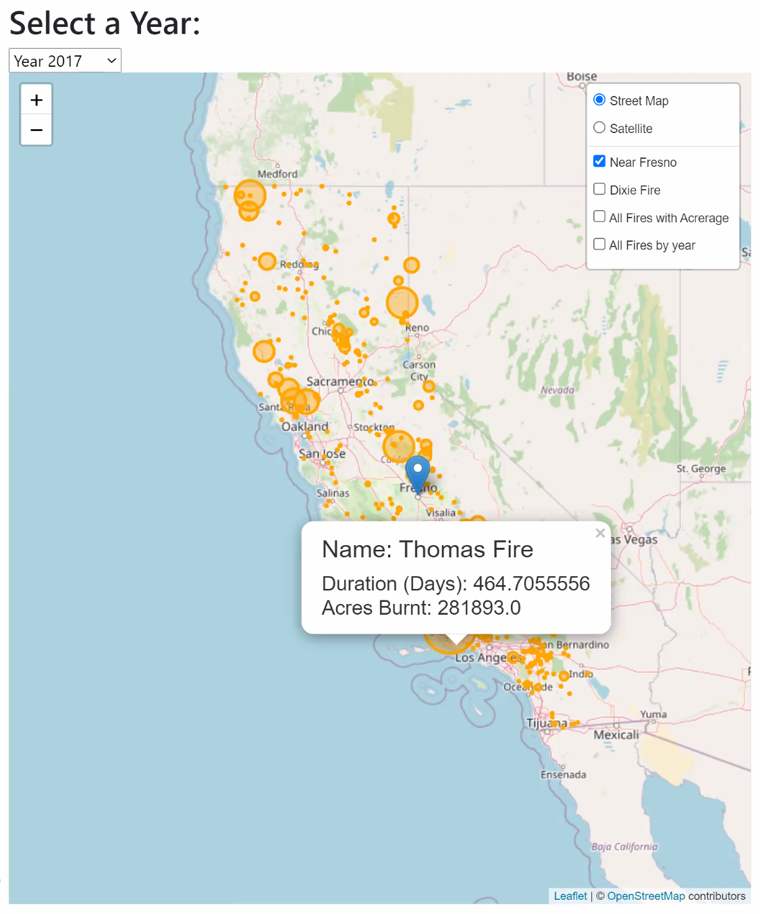
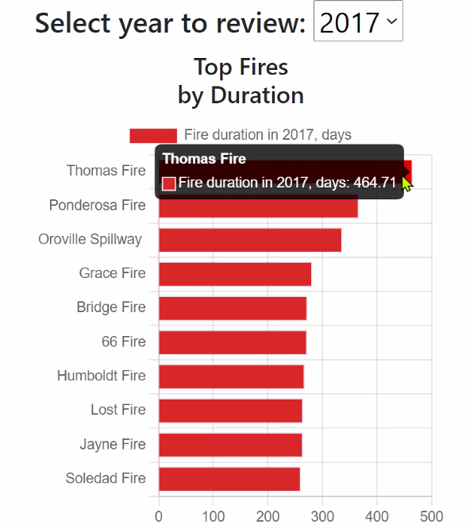
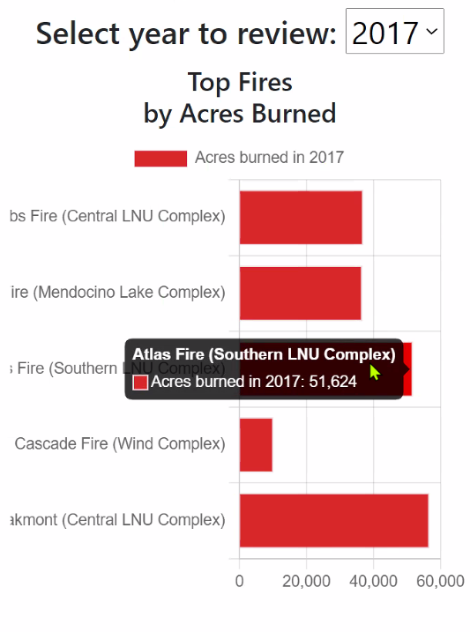
Visualizations
Longest running fires selectable by year with pop-ups containing specific duration
Map of fire locations, selectable for individual years or all available data, sized by acreage multiplied by 100
Largest fires selectable by year with pop-ups containing total acreage
Notes:
We created a map to easily visualize the number of vaccine-related deaths across each state in the US using a library called plotly.graph_objects
Unsurprisingly, these figures are the highest in states with the largest populations
California: 304 deaths, Florida: 192 deaths, Illinois and NY: 179 deaths each and Texas: 168 deaths
But do these states have the highest mortality rate? Let’s see...

Slide 11
Key Points and Takeaways
Fire is a natural phenomena exacerbated in the American West by a century of suppression, changing density of fuels, development and increased wildland/urban interface, and changing climate.
Understanding the impact of fire can be enhanced through visualization of data.
Scale is difficult to comprehend based solely on a number. What does 570,000 acres look like?
Immediately we see three distinct visually compelling, conclusory connections to the data.
The Central Valley doesn’t burn, or “Nothing grows in death valley.”
Fires overlap with major metropolitan areas along the coast, or “It’s not just the distant mountains that burn.”
In aggregate, fire numbers and size have increased over the years the data set spans, or “It’s getting worse.”
The visual connection created through mapping begs additional questions beyond the scope and time of this project.
What about accurate fire perimeter maps instead of circles scaled to the total acreage?
What about weather data, specifically drought years?
What do other states look like?
Questions and/or Comments?

